Slide 1
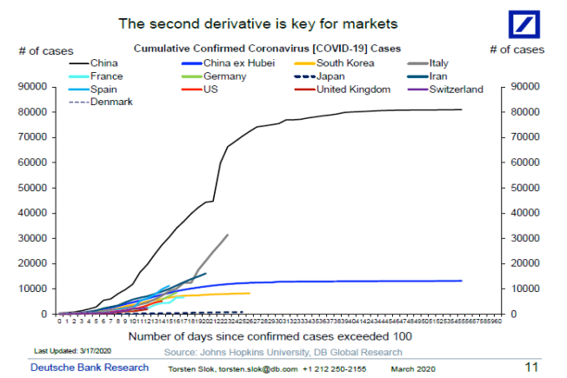
REFERENCE MATERIAL ONLY
All consulting and training materials are provided “as-is” and without any warranties; use of and/or reliance on these materials is at your own risk. Consulting and training materials may not be reproduced, used, or sold in whole or in part, in any manner, without written consent or license. This is publicly available information shared as requested and does not in any way constitute investment, legal or medical advice and is used at the recipient’s discretion.
COVID-19 REVIEW
Flattening The Curve: Data 3/16/2020
Mitigating the rate of growth of COVID-19 and stretching the response over a longer time frame is the goal so the healthcare system is not overwhelmed. Growth rates appear to be highest over the first two weeks after cases exceed 100 people.
  Most recent data shows growth rates in new cases have declined in both Italy and Spain.
Government/Healthcare Response
  Testing improvements and policies are improving –human testing begins earlier than expected (Moderna)
  Corporate America has rapidly deployed social distancing measures to contain the spread and maintain business continuity.

Slide 2
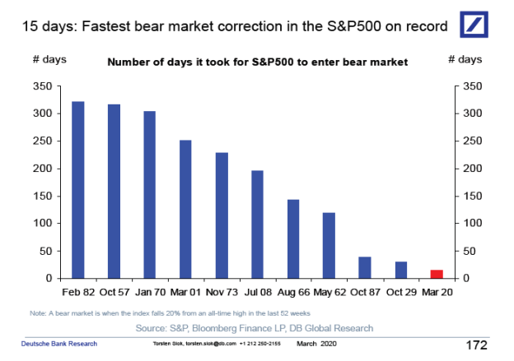
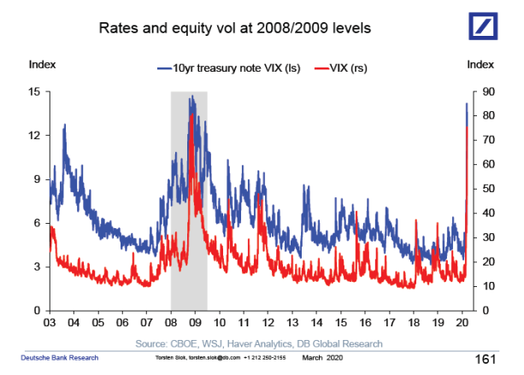
REFERENCE MATERIAL ONLY
All consulting and training materials are provided “as-is” and without any warranties; use of and/or reliance on these materials is at your own risk. Consulting and training materials may not be reproduced, used, or sold in whole or in part, in any manner, without written consent or license. This is publicly available information shared as requested and does not in any way constitute investment, legal or medical advice and is used at the recipient’s discretion.
HISTORICAL CONTEXT Slide 2
Historical Context:
We are in the “fastest” bear market of all time. Roughly twice as fast as the crash of 1929 and the 1987 stock market correction.
In periods of extreme stress, 10 Year Treasury yields and the VIX spike in tandem. We are now at levels similar to the 2008/2009 crisis. Importantly, we consider this is a very different situation to 2008/2009.

Slide 3
REFERENCE MATERIAL ONLY
All consulting and training materials are provided “as-is” and without any warranties; use of and/or reliance on these materials is at your own risk. Consulting and training materials may not be reproduced, used, or sold in whole or in part, in any manner, without written consent or license. This is publicly available information shared as requested and does not in any way constitute investment, legal or medical advice and is used at the recipient’s discretion.
3 TYPES OF BEAR MARKETS
Structural: Imbalances and asset bubbles (2008 and dot.com)
Cyclical: Caused by the natural economic cycle, usually rising rates and inflation leading into recession
Event Driven: exogenous shock to the system (COVID-19)

Slide 4
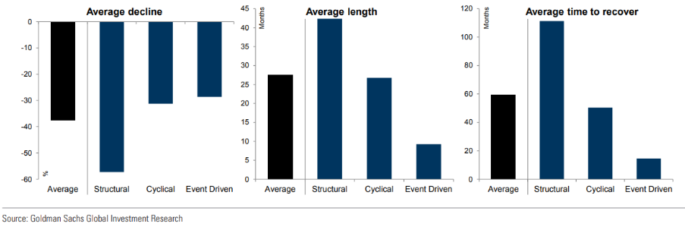
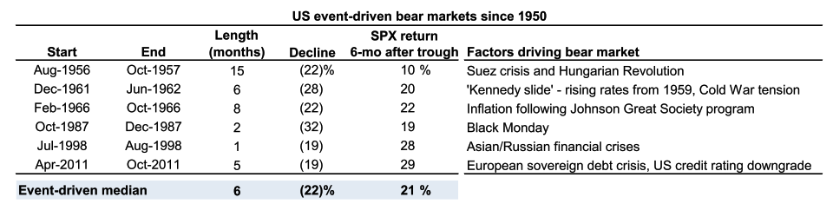
REFERENCE MATERIAL ONLY
All consulting and training materials are provided “as-is” and without any warranties; use of and/or reliance on these materials is at your own risk. Consulting and training materials may not be reproduced, used, or sold in whole or in part, in any manner, without written consent or license. This is publicly available information shared as requested and does not in any way constitute investment, legal or medical advice and is used at the recipient’s discretion.
EVENT DRIVEN BEAR MARKETS
Historical Perspective:
In the six prior event driven bear markets, the average decline was -22% & average return 6 months after the trough was +21%.
The current correction is roughly -30% and occurred in less than one month.
Average declines for event driven tend to be less than average, but importantly, average length and average time to recover are much shorter.

Slide 5
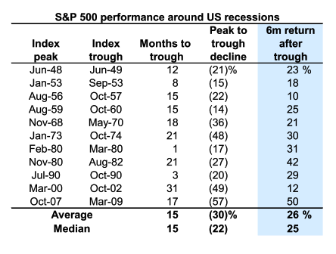
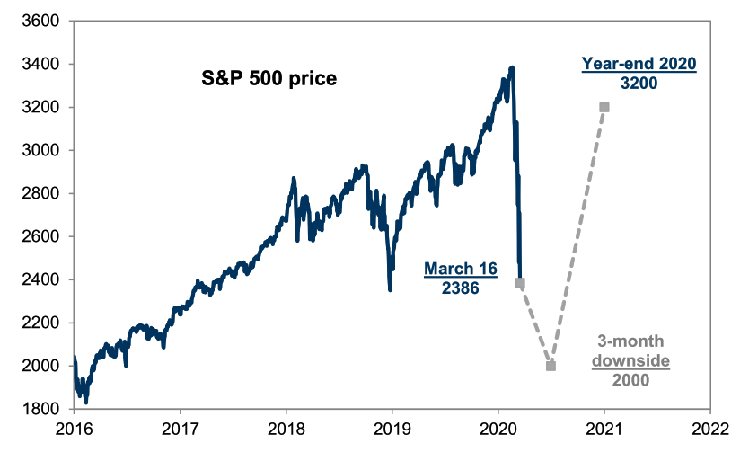
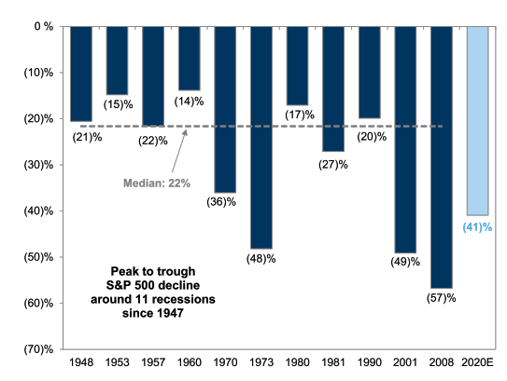
REFERENCE MATERIAL ONLY
All consulting and training materials are provided “as-is” and without any warranties; use of and/or reliance on these materials is at your own risk. Consulting and training materials may not be reproduced, used, or sold in whole or in part, in any manner, without written consent or license. This is publicly available information shared as requested and does not in any way constitute investment, legal or medical advice and is used at the recipient’s discretion.
INVESTMENT FORECASTS
Quick Facts:
Goldman maintains their downside forecast of ~2,000 on the S&P 500 over the next 3 months.
Goldman also maintains their year end target of 3,200 indicating a potential trough to year end return of +60%.
The average peak to trough decline in a bear market over the previous 11 recessions has been -30%. The subsequent 6 month return after the trough has been +26%
If Goldman’s 2020 forecasts prove accurate, the peak to trough decline of the S&P 500 will be -41% and the trough to peak rally will be approximately +60%.

Slide 6
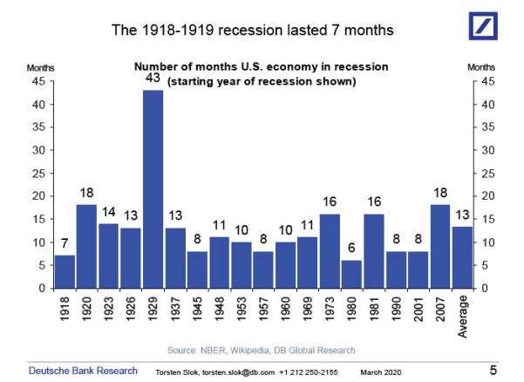
REFERENCE MATERIAL ONLY
All consulting and training materials are provided “as-is” and without any warranties; use of and/or reliance on these materials is at your own risk. Consulting and training materials may not be reproduced, used, or sold in whole or in part, in any manner, without written consent or license. This is publicly available information shared as requested and does not in any way constitute investment, legal or medical advice and is used at the recipient’s discretion.

Slide 7
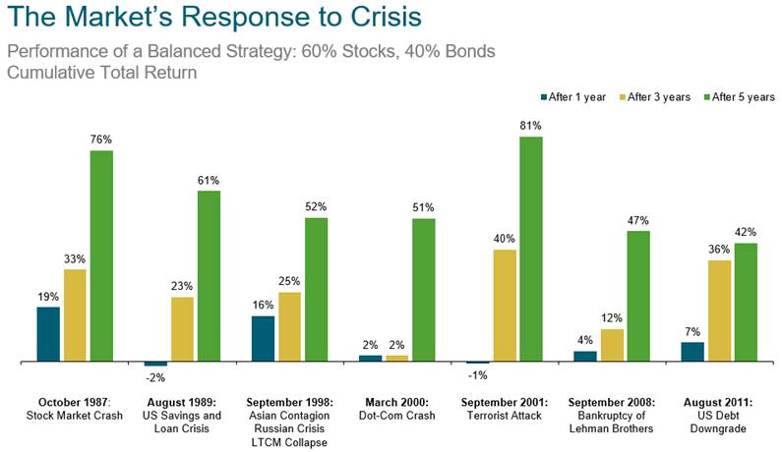
REFERENCE MATERIAL ONLY
All consulting and training materials are provided “as-is” and without any warranties; use of and/or reliance on these materials is at your own risk. Consulting and training materials may not be reproduced, used, or sold in whole or in part, in any manner, without written consent or license. This is publicly available information shared as requested and does not in any way constitute investment, legal or medical advice and is used at the recipient’s discretion.

Slide 8
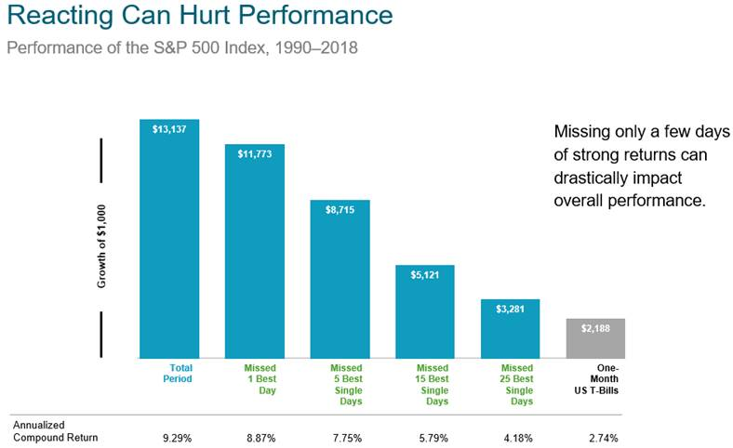
REFERENCE MATERIAL ONLY
All consulting and training materials are provided “as-is” and without any warranties; use of and/or reliance on these materials is at your own risk. Consulting and training materials may not be reproduced, used, or sold in whole or in part, in any manner, without written consent or license. This is publicly available information shared as requested and does not in any way constitute investment, legal or medical advice and is used at the recipient’s discretion.

Slide 9
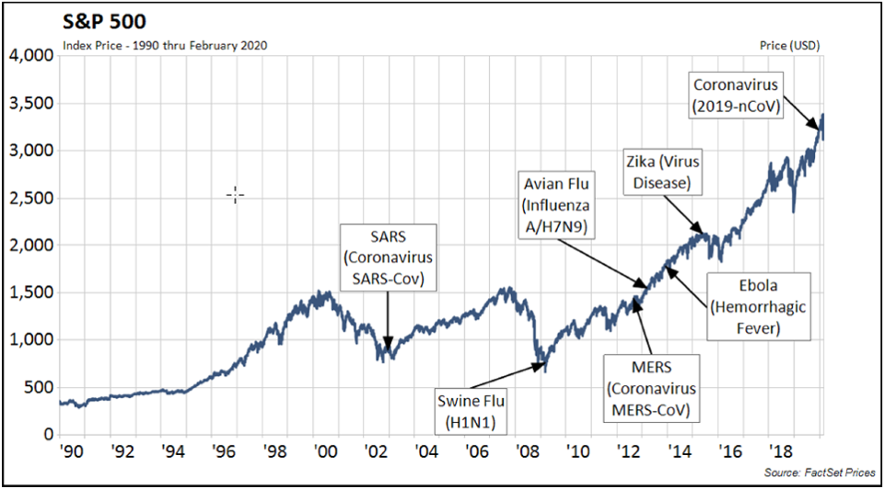
REFERENCE MATERIAL ONLY
All consulting and training materials are provided “as-is” and without any warranties; use of and/or reliance on these materials is at your own risk. Consulting and training materials may not be reproduced, used, or sold in whole or in part, in any manner, without written consent or license. This is publicly available information shared as requested and does not in any way constitute investment, legal or medical advice and is used at the recipient’s discretion.

Slide 10
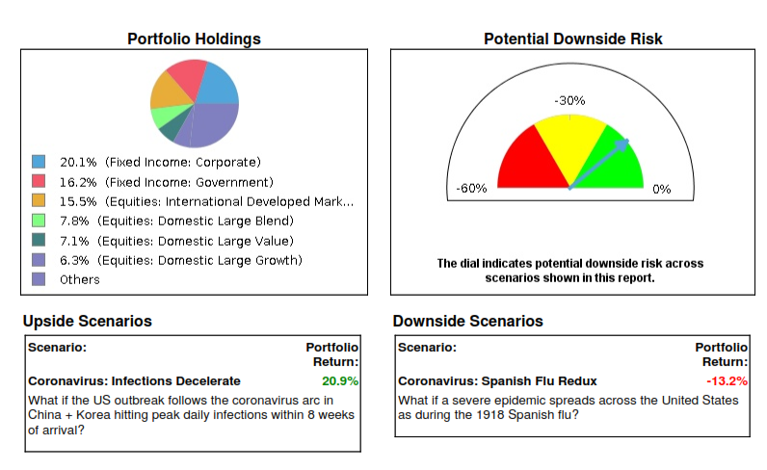
PORTFOLIO STRESS TEST
REFERENCE MATERIAL ONLY
All consulting and training materials are provided “as-is” and without any warranties; use of and/or reliance on these materials is at your own risk. Consulting and training materials may not be reproduced, used, or sold in whole or in part, in any manner, without written consent or license. This is publicly available information shared as requested and does not in any way constitute investment, legal or medical advice and is used at the recipient’s discretion.

Slide 11
REFERENCE MATERIAL ONLY
All consulting and training materials are provided “as-is” and without any warranties; use of and/or reliance on these materials is at your own risk. Consulting and training materials may not be reproduced, used, or sold in whole or in part, in any manner, without written consent or license. This is publicly available information shared as requested and does not in any way constitute investment, legal or medical advice and is used at the recipient’s discretion.
ACTIONS RECOMMENDED
Recommendations:
Be communicative with clients but remain disciplined. If they are 50% stocks and 50% fixed income & their FP allows it, consider methodically ratcheting them up into more equity exposure as market opportunities dictate. Having cases loaded ahead of time and client conversations documented so you are pro-active and can be nimble on timing.
  Option 1) make the move from 50-50 => 60-40
  Option 2) half now, half in a month when we rebalance
  Option 3) (default option): we will trade across accounts as part of our regular rebalance
In a yield starved world, consider rotating into Direct models with available direct investments:
Opportunities for tax loss harvesting are abundant. Create tax loss harvesting strategies for your clients and communicate the after tax value. Share with their CPAs.
Diversify concentrated legacy stock positions where it makes sense. Lower unrealized gains associated with these positions today, so consider rotating into a more diversified basket of stocks, while maintaining same equity exposure.

